Slide 1
BATTLE OF NEIGBORHOODS

Slide 2
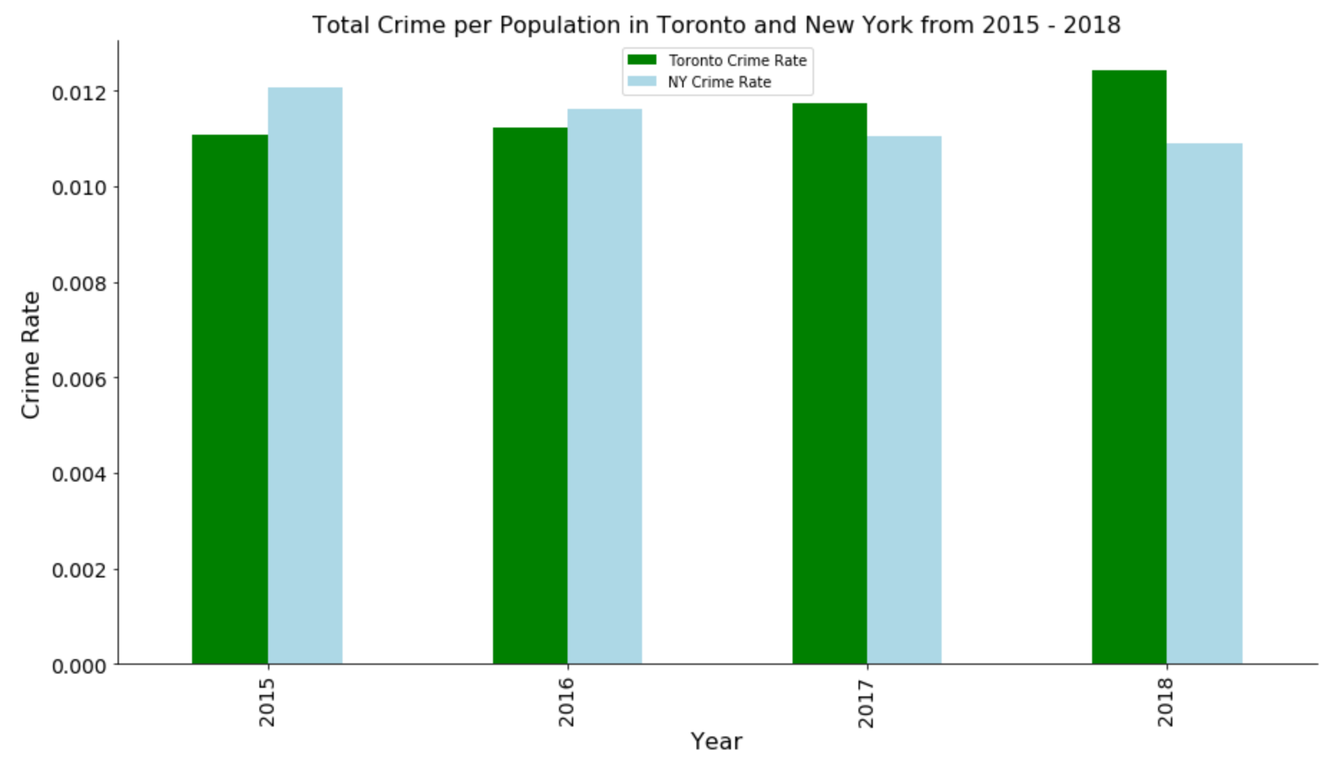
TOTAL CRIME PER POPULATION

Slide 3
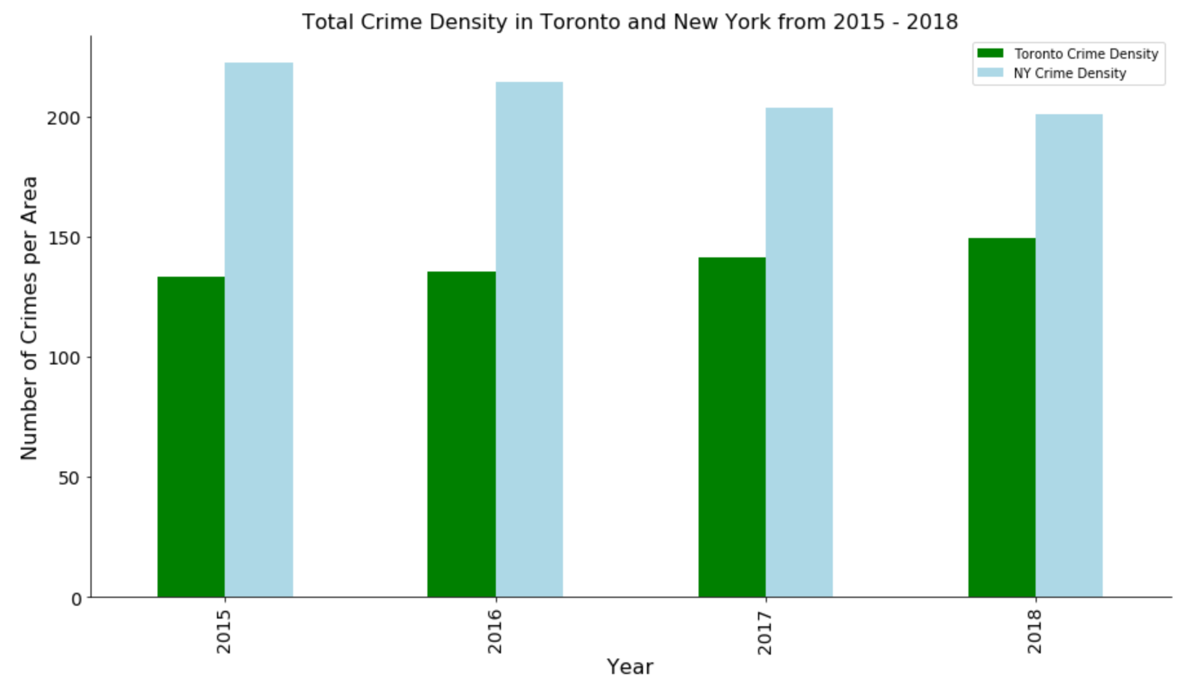
TOTAL CRIME DENSITY

Slide 4
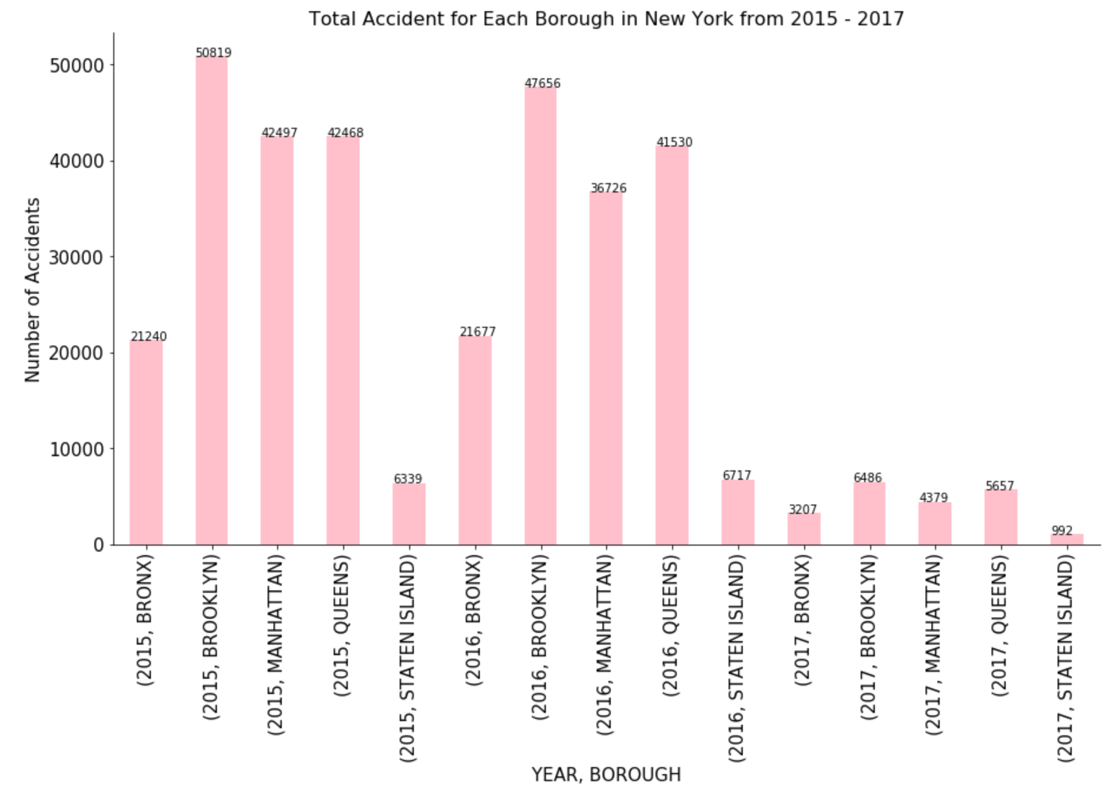
TOTAL OF ACCIDENTS In New York City

Slide 5
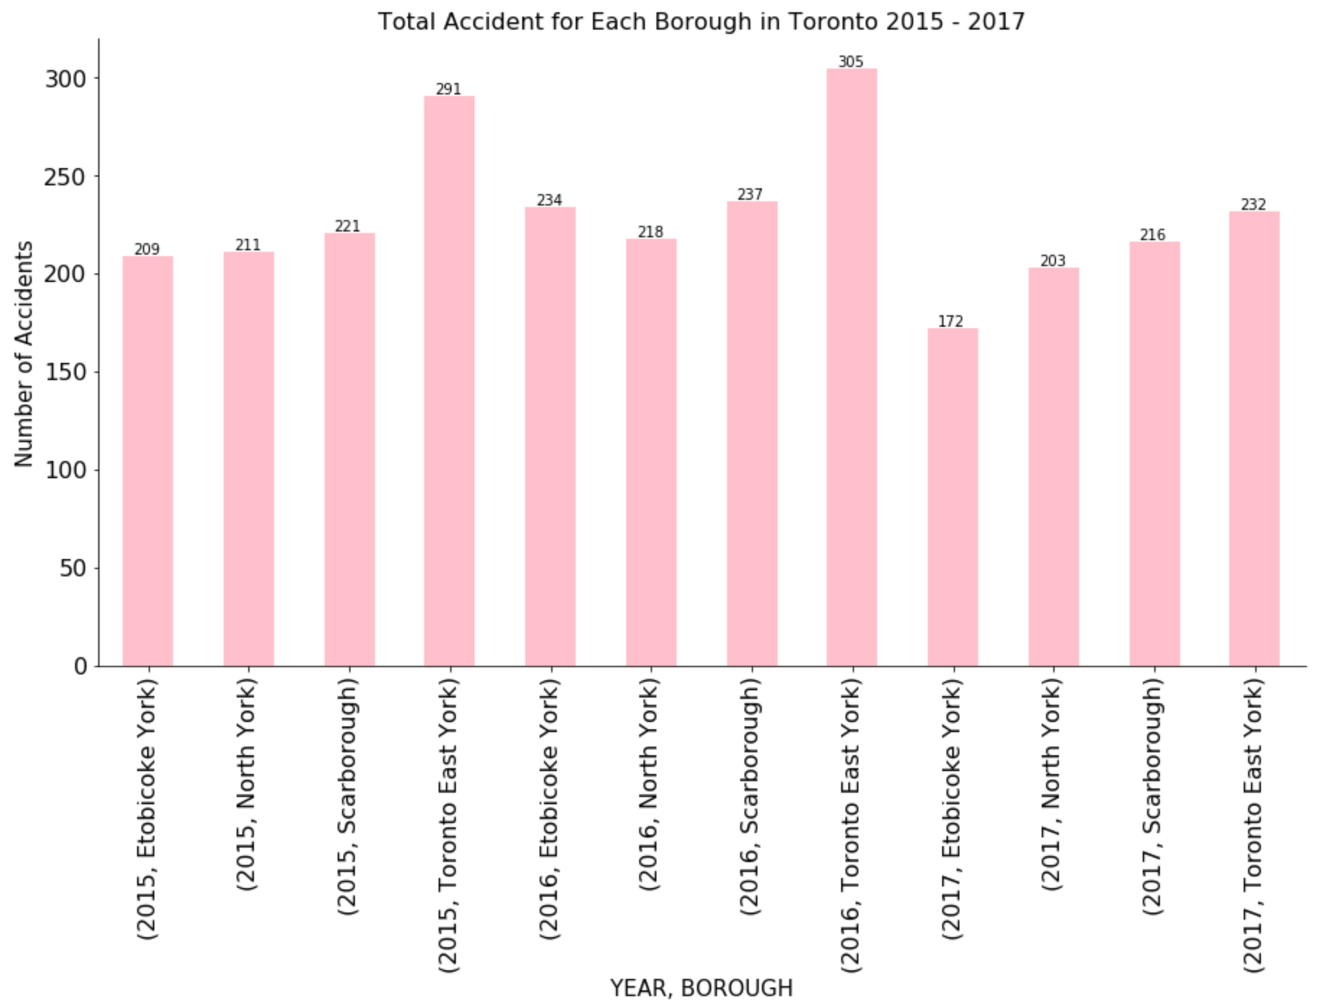
TOTAL OF ACCIDENTS in City of Toronto

Slide 6
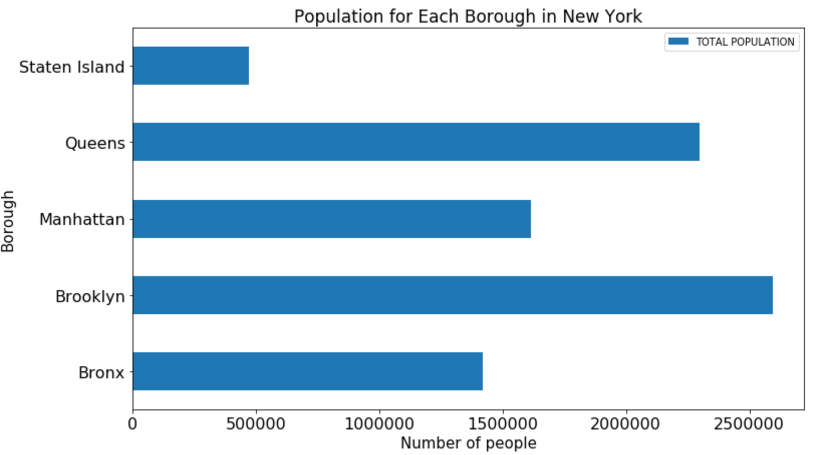
NEW YORK CITY POPULATION

Slide 7
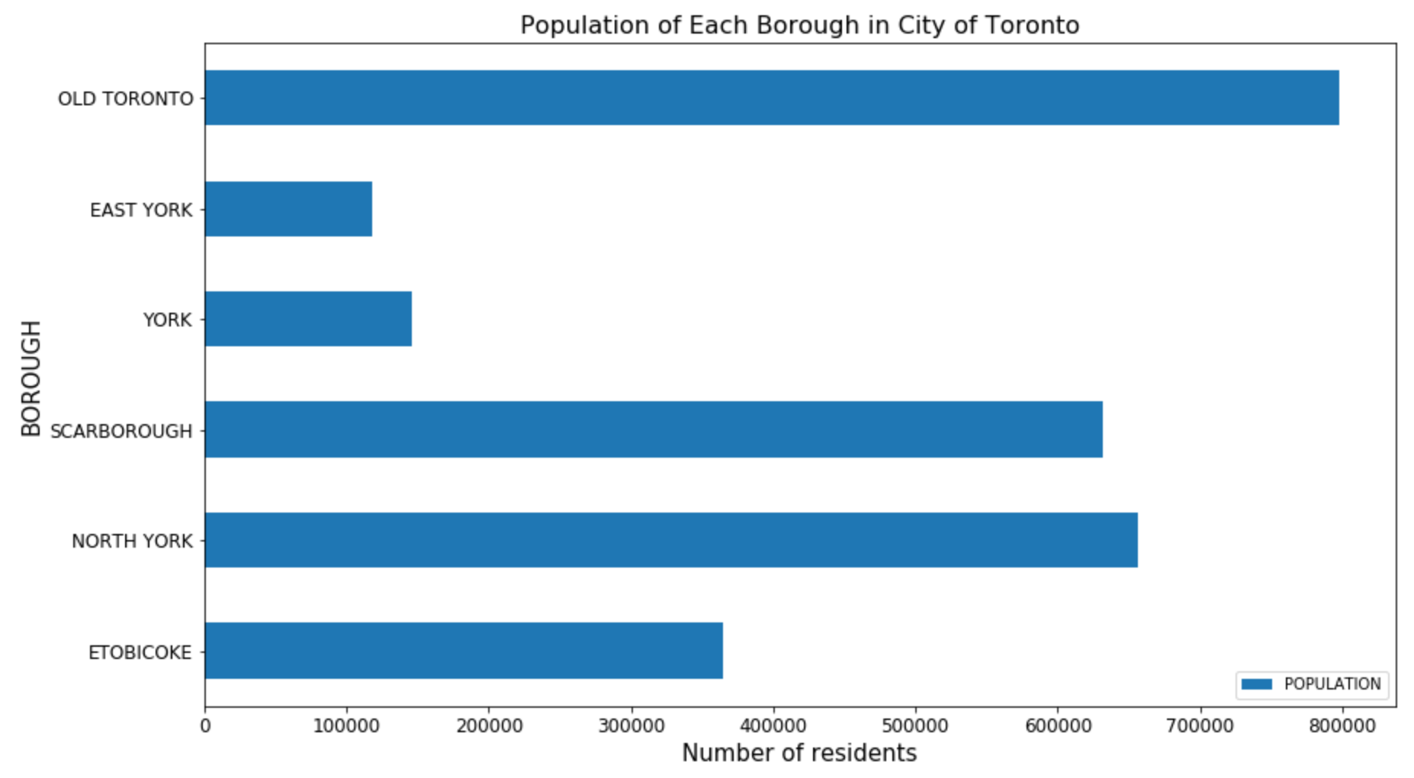
CITY OF TORONTO POPULATION

Slide 8
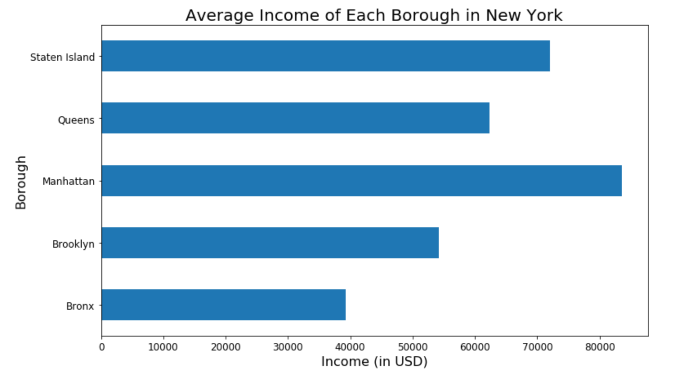
AVERAGE INCOME OF NYC

Slide 9
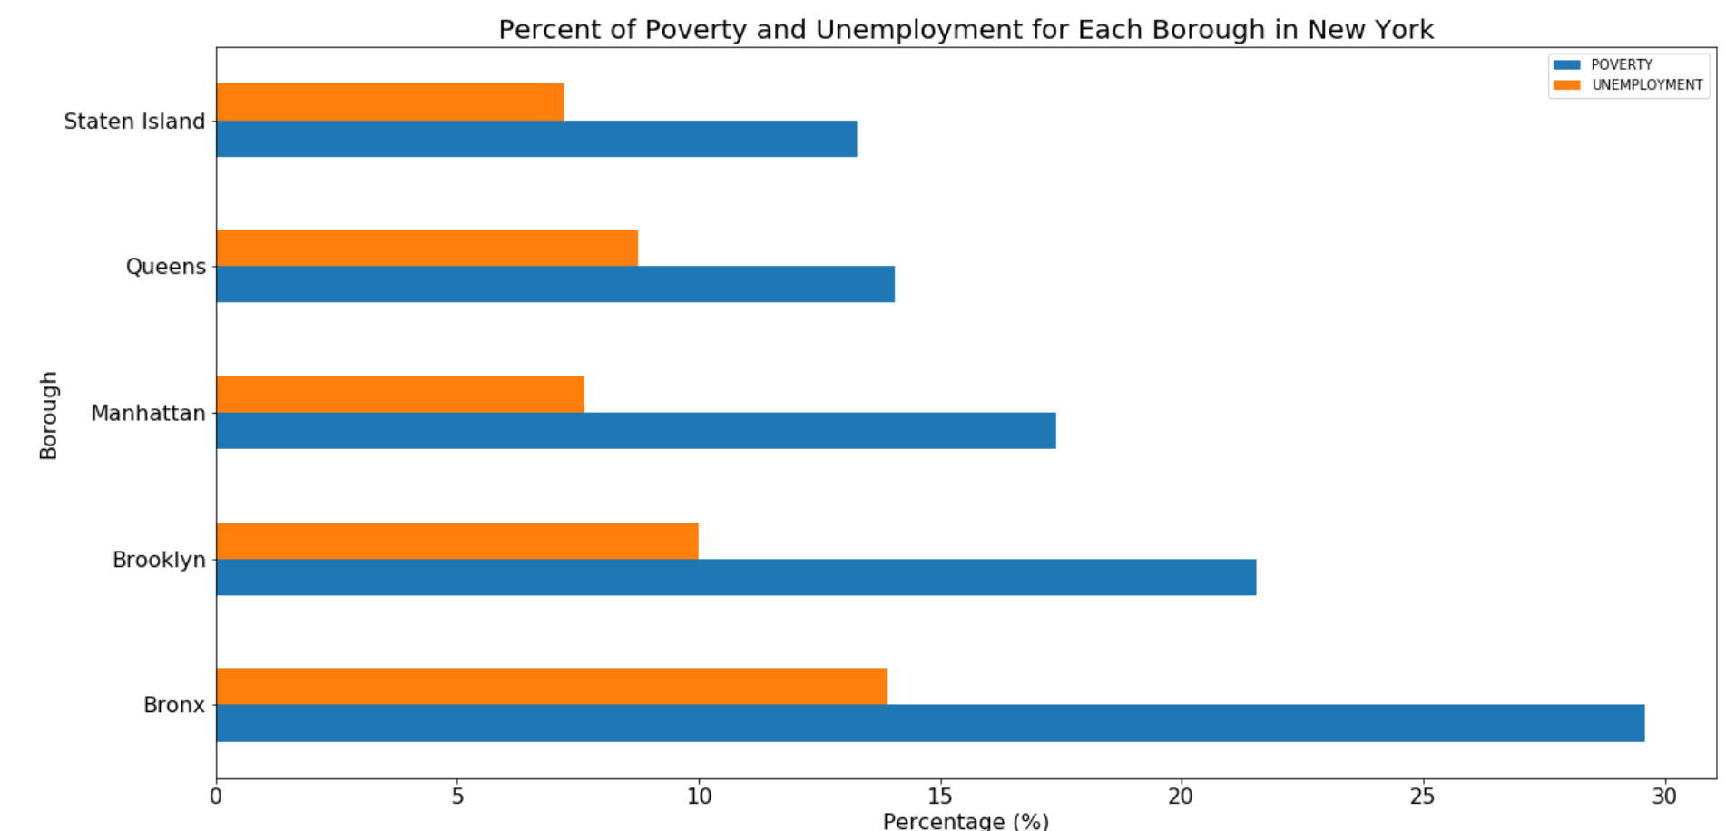
POVERTY AND UNEMPLOYMENT IN NYC

Slide 10
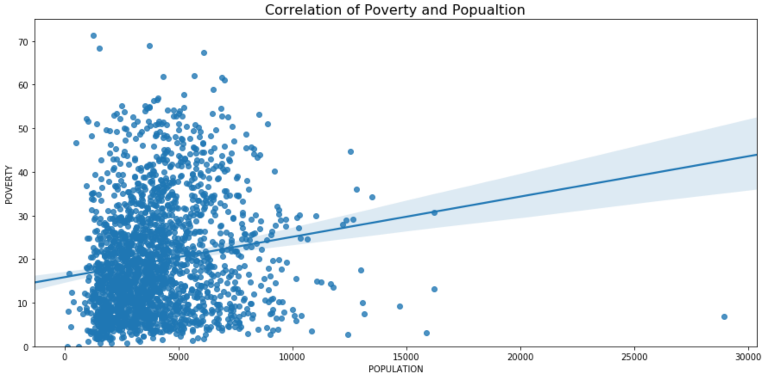
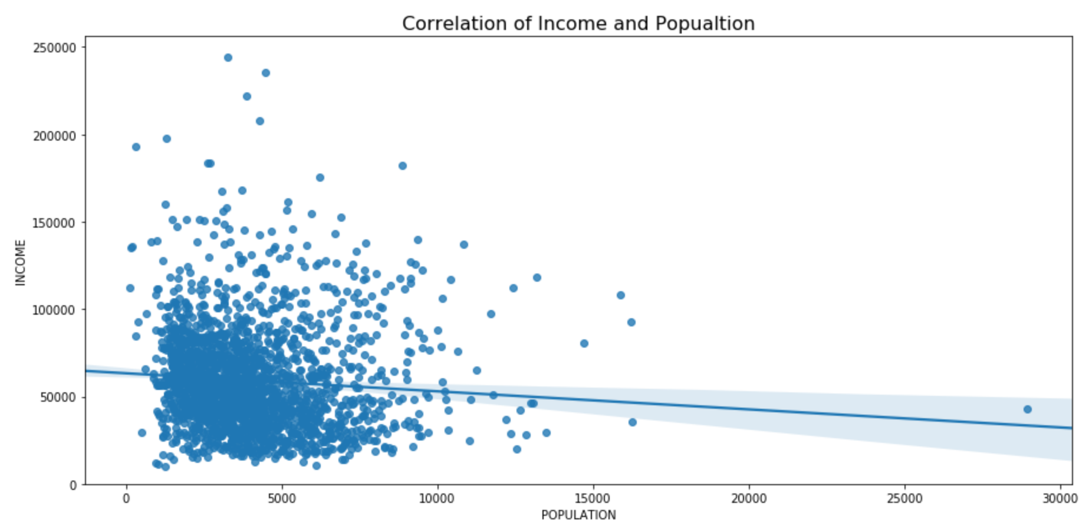
CORRELATION

Slide 11
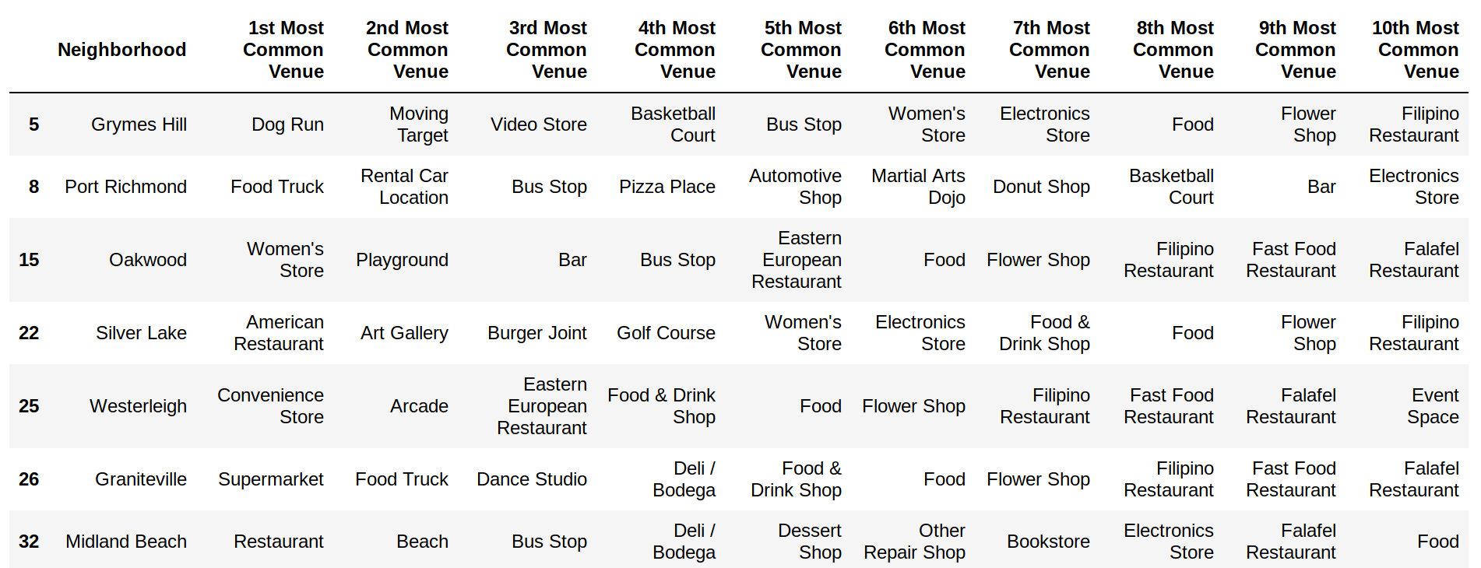
SUGGESTED LOCATION OF RESTAURANT
- Graniteville

Slide 12
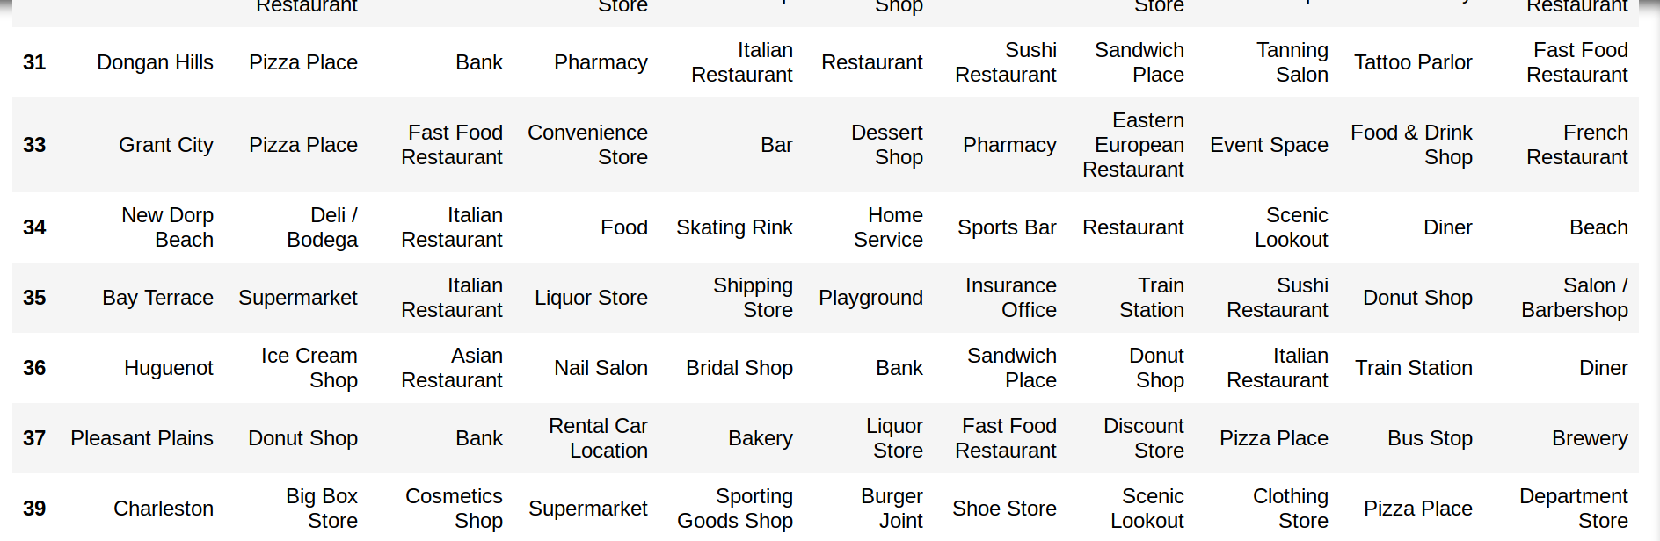
SUGGESTED LOCATION OF RESTAURANT
- CHARLESTON

Slide 13
SUGGESTED LOCATION OF OFFICE
- DONGAN HILLS
- GRANT CITY

